Slide 1
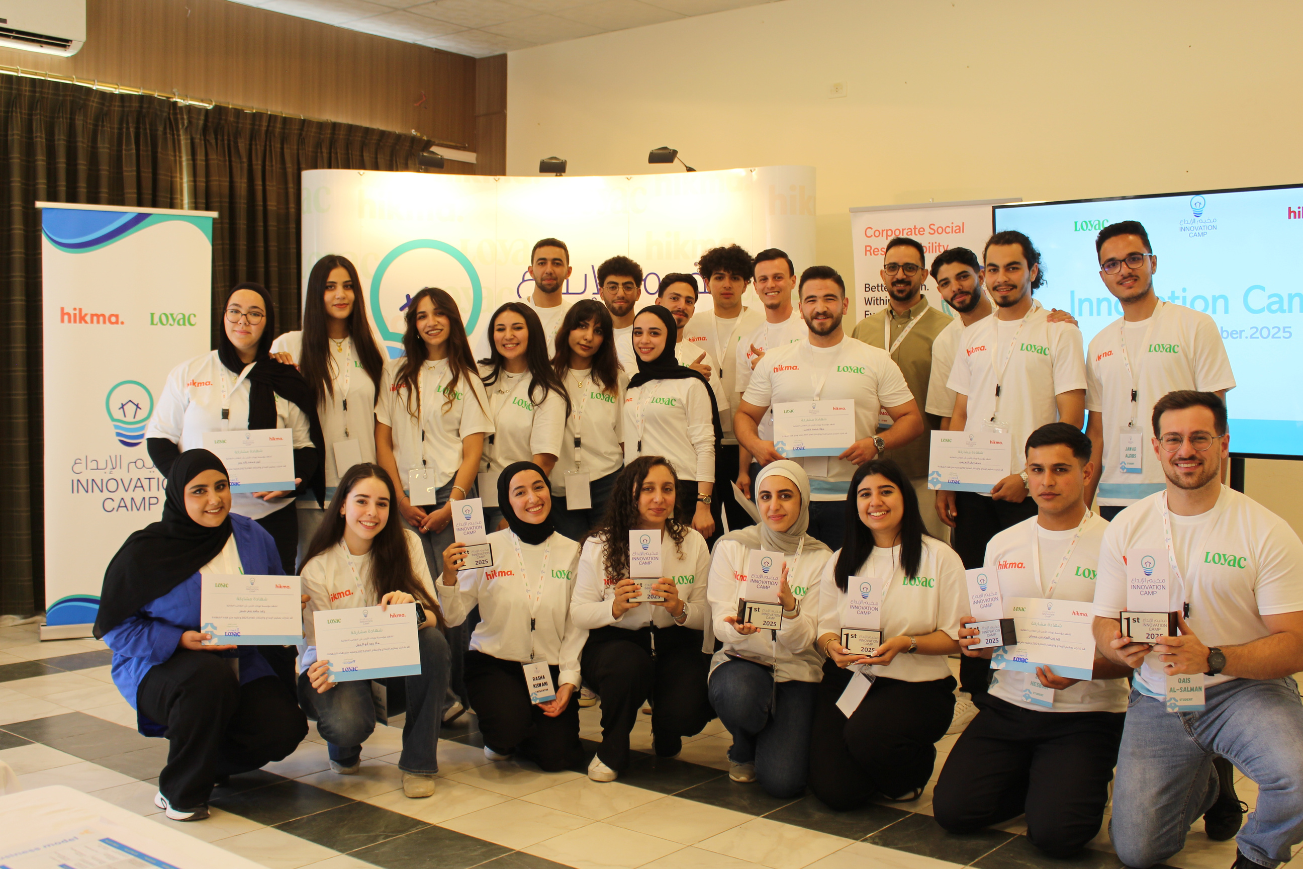

Annual
Report
20
25

Slide 2
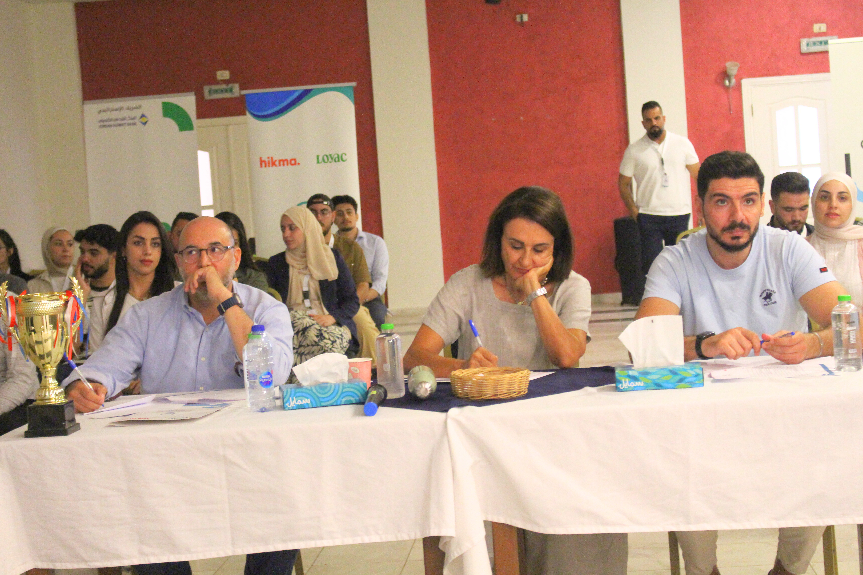

Chairperson letter
Dear LOYAC Friends,
On behalf of everyone at LOYAC, I would like to extend our heartfelt gratitude for your generous support and belief in our mission to empower and inspire Jordanian youth. Your contribution has played a pivotal role in enabling us to provide meaningful opportunities, programs, and services that nurture young minds and equip them to build a better tomorrow.
Thanks to your generosity, last year we were able to provide over 1,901 Jordanian Youth with employability skills training, internship opportunities, innovative thinking workshops, and volunteering opportunities; all of which positively impact not only the lives of these young individuals, who participate in our programs, but also create a ripple effect that benefits their families and communities.
It is with the help of committed partners like you that LOYAC continues to thrive and make a difference. Your trust in our vision fuels our determination to innovate, grow, and stay true to our mission.
As we reflect on our accomplishments and look forward to the future, we are reminded of the invaluable role you play in our journey.
Once again, thank you for your generosity and dedication. We are truly grateful for your partnership and look forward to achieving more milestones together. With deepest gratitude,
Rula Abu Rayyan Jardaneh
Chairperson
Page 1

Slide 3
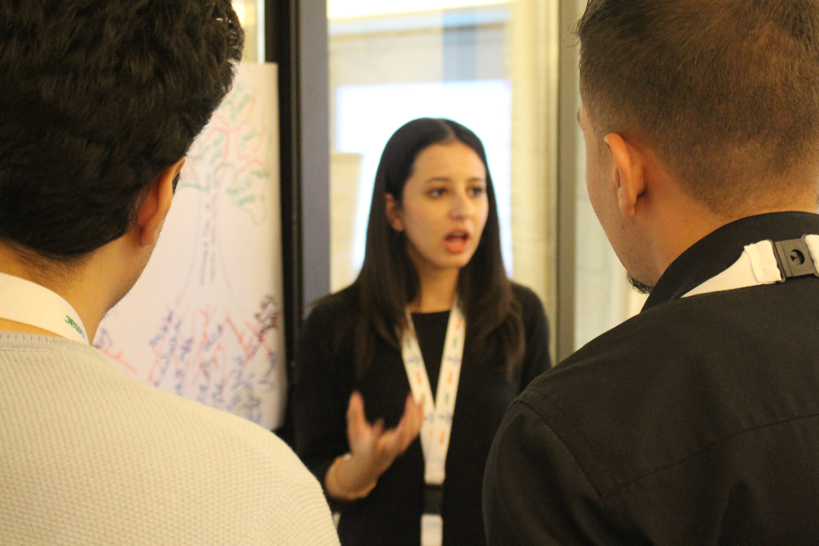
Board of Directors :
-Rula Abu Rayyan Jardaneh – Chairperson
-Hani Rabie – Vice Chairperson
-Reem Mouasher – Secretary of the Board
-Runa Sindaha – Board Member
-Haya Marei – Board Member
-Mai Al Hosari – Board Member
-Fareah Al Saqqaf – Founder and Managing Director of LOYAC Kuwait
-Salwa Katkhuda – Board Member
-Farah Mawla – Board Member
-Naim Nassar – Board Member
-Iyad Zawaideh – Board Member
Founders:
-The Honorable Nisreen Zaid Bin Shaker
-Rula Abu Rayyan Jardaneh
-Hani Rabie
-Reem Mouasher
-Noor Belbeisi
-Hiam Azar
-Alia Marei
-Fareah Al Saqqaf
Page 2

Slide 4
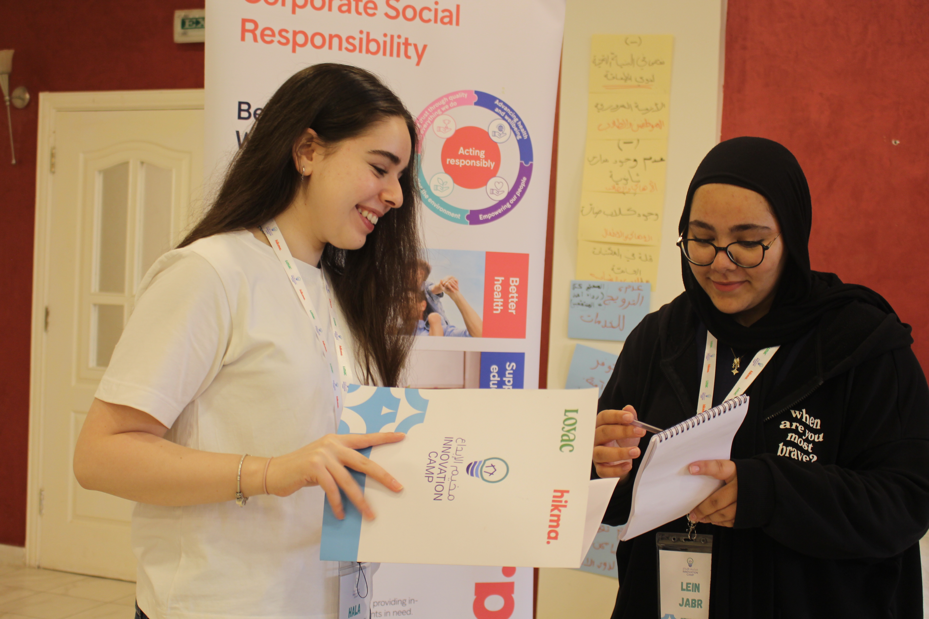
Founded in 2008 as a volunteer initiative, LOYAC has helped Jordanian youth gain summer jobs and internships to prepare for the job market. In its first year, it placed 75 students in summer jobs and matched 50 with internships. Seventeenth years later, LOYAC has trained over 23,000 students and placed more than 15,000 in internships, contributing over 406,000 hours of community service.
LOYAC supports the professional development of youth by providing practical experiences that enhance their skills and empower their decision-making. With a dedicated staff and an active Board of Directors, LOYAC collaborates with numerous partners to implement its programs.
Today, 68% of LOYAC graduates, 70% of which are young women, are employed.
100% of LOYAC graduates are actively engaged in their communities.
As our youth grow, we grow.
The more our youth work, the more we work!
Mission
LOYAC aims to improve employability and increase the personal agency of youth in Jordan so that they can lead independent, productive, and fulfilled professional and personal lives.
Vision
Youth in Jordan work and engage with others as empowered, self-motivated, and fulfilled individuals who nurture, inspire, and effectively contribute to their families, their workplaces, and their communities.
Page 3

Slide 5
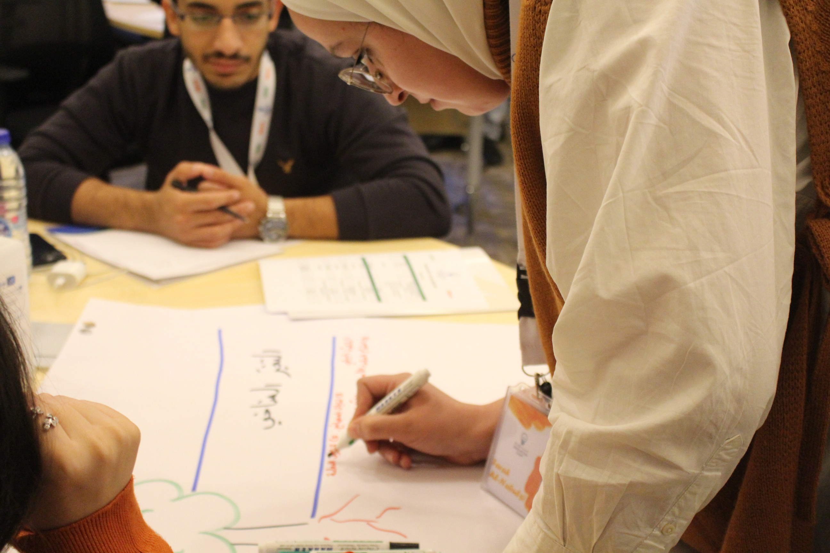
Programs
“What we do”
LOYAC’s programs work with youth to:
1. Build a positive life ethos and work ethic.
2. Gain skills that will enable their personal and professional lives.
3. Bridge the gaps between studies, applied and life skills, labor supply, and changing job market demands and realities.
Simply, we work.
And, the more we work, the more our youth get work!
Page 4

Slide 6
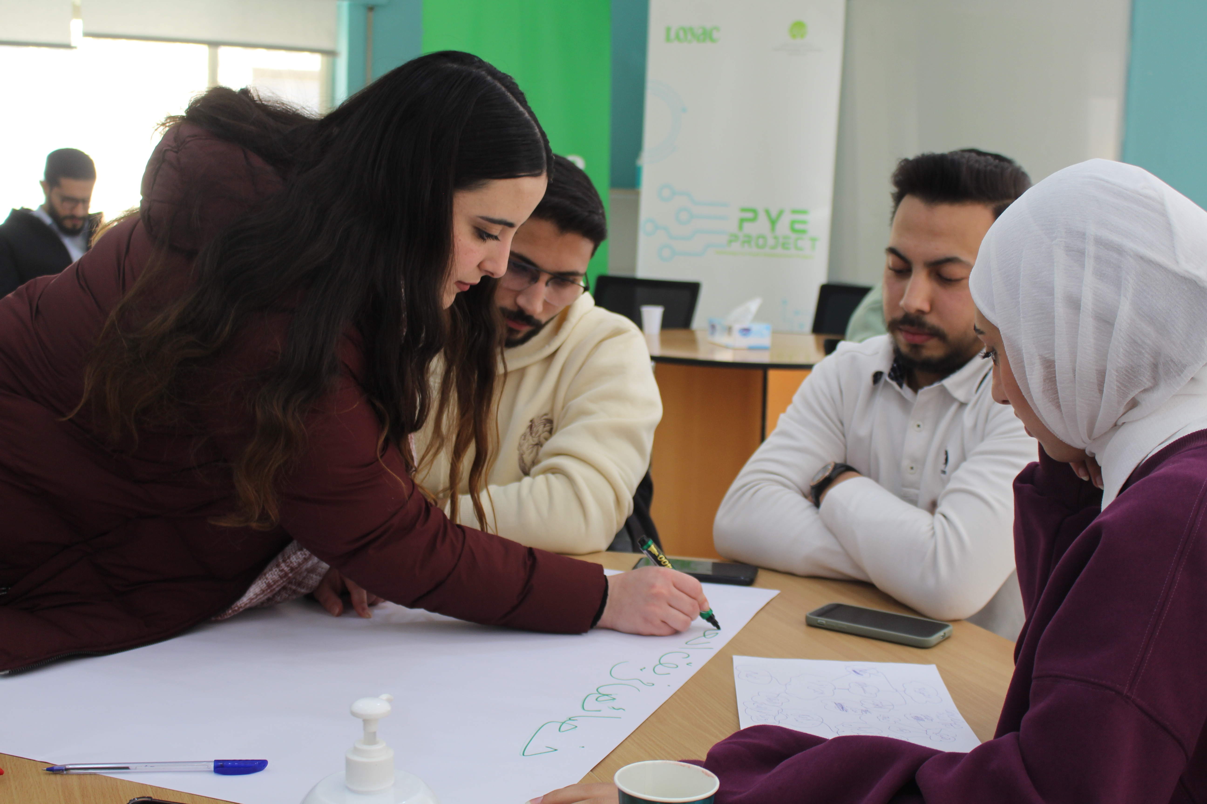
Summer Internship Program
The Summer Internship Program is a nationwide initiative offering 6-8 week paid internships for university students and recent graduates during the summer. Designed to bridge the gap between education and employment, the program provides practical training and workplace experience aligned with participants’ fields of study or interest. Through workshops and internships, it equips students with essential skills, fosters independence, and responsibility, and promotes active community engagement, creating an environment of acceptance and appreciation for diverse talents.
Program goals:
Bridge the gaps between theoretical studies and the changing demands and realities of the local and regional job market.
Make career choices that will lead to gainful, sustainable employment.
Develop skills that will enable positive growth and agency in their personal and professional lives.
Enhance their self-confidence and interpersonal skills in order to cope better with challenges as they progress through their careers.
Build a more positive life ethos and work ethic.
Summer Internship Program 2025 was sponsored by Jordan Kuwait Bank.
Soft Skills Training
Internship Opportunities
Companies
Community Service Hours
761
573
95
+6000
91% of graduating students secured full time employment
Page 5

Slide 7

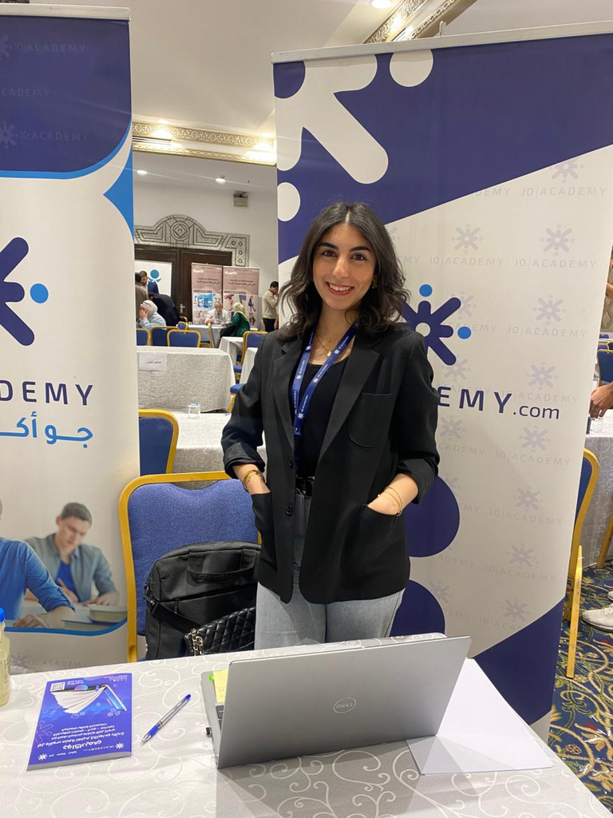
Alaa Samara
HR Officer at Jo Academy.
Fresh graduated from the Political Science faculty of Hashemite University.
My journey with LOYAC began at a young age, driven by a passion for volunteering and creating meaningful impact. After enrolling in LOYAC’s Summer Internship Program, I developed essential workplace skills and gained a deeper understanding of professional environments. Through soft skills training, I was able to build a strong CV and a professional digital identity, which significantly boosted my confidence and readiness for the job market.
LOYAC then connected me with a internship opportunity at Jo Academy, which became a pivotal milestone in my professional journey. This experience allowed me to grow both personally and professionally and ultimately led to my employment at Jo Academy. My story reflects the powerful role LOYAC plays in empowering youth and transforming early potential into real career opportunities.
Page 5
Page 6

Slide 8
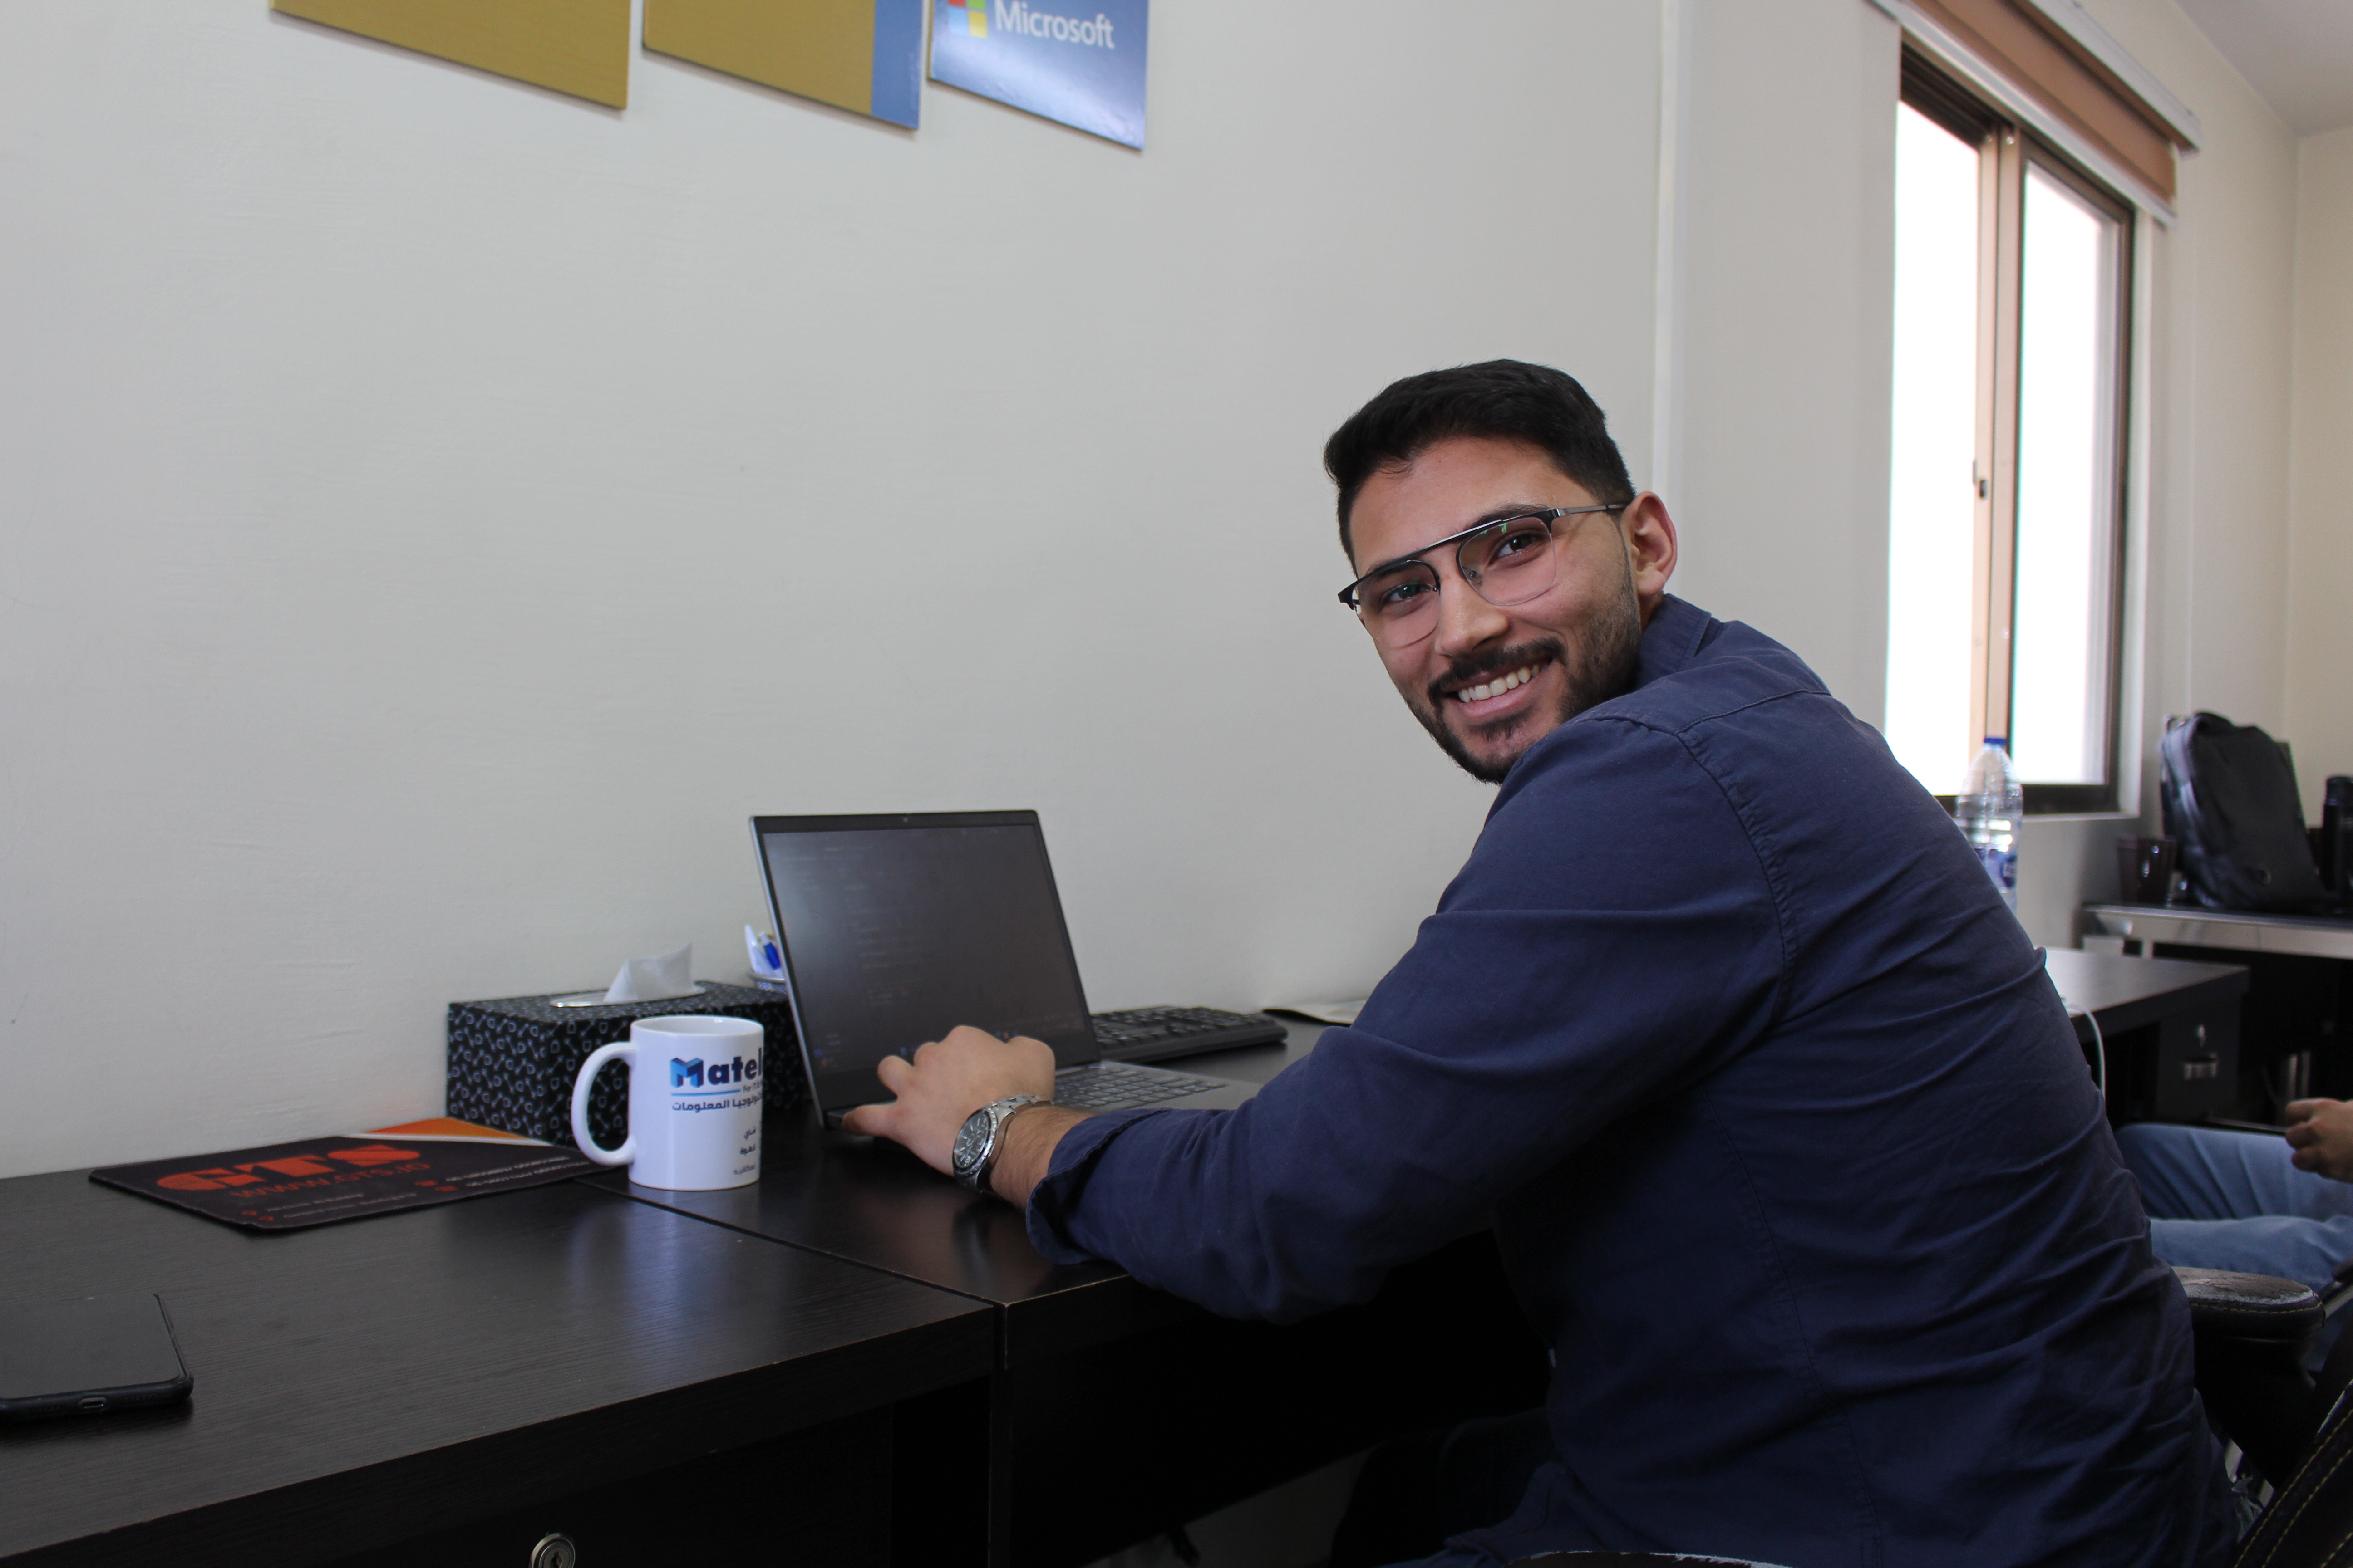
Pathways Youth Employment Project (PYE Project)
Pathways to Youth Employment (PYE) is a project that is implemented jointly between LOYAC and Tawfiq & Nimat Fakhouri Initiative project which aims to create a productive generation of workforce-ready and employable youth who are excited about joining the workplace, specifically within the private sector.
PYE aims at providing an opportunity for fresh graduates to intern in companies in the Information and Communications Technology sector, provide them with technical and life skills training and compete at a chance of retaining jobs within those companies. The internship phase at companies is for 3 months where companies can see the performance of project participants and choose suitable candidates to fill the vacancies within the company.
The stages of PYE project are:
1.Soft Skills training.
2.Technical Training.
3.Internship.
4.Employment.
Soft Skills Training
Technical Training
Internship
Employment
97
86
86
69
Page 7

Slide 9
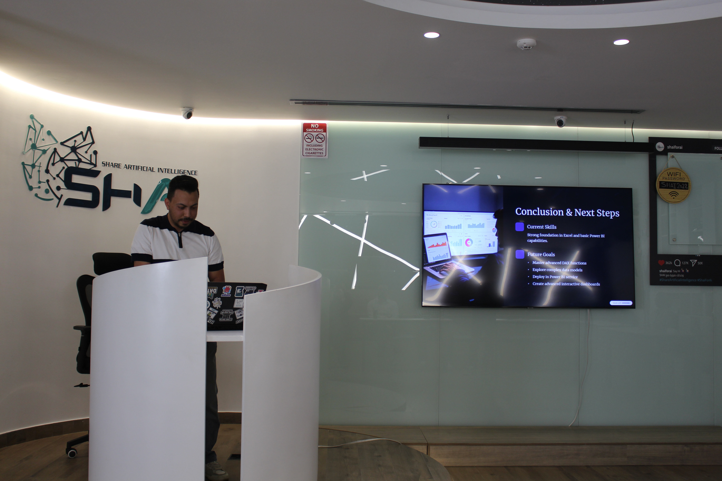
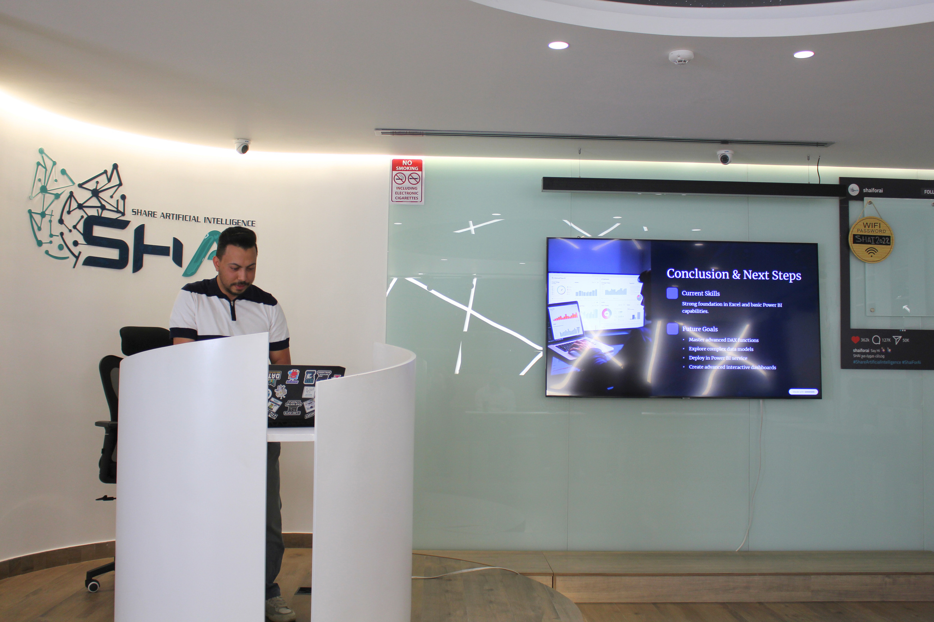
Abdelaziz Masadeh
Sales& Implementation Coordinator at Al Zafer Investment Co.Ltd
Graduated from Al-Ahliyya Amman University.
Driven by a strong passion for technology and the ongoing digital transformation, I chose this field to better understand how systems and software shape today’s world. During my academic journey, I built a solid foundation in programming, system analysis, and database management, which strengthened my analytical thinking and problem-solving skills.
My participation in LOYAC’s Pathways to Youth Employment (PYE) project marked a significant turning point in my professional development. Through the project, I received specialized training in data analysis, developed essential workplace skills such as teamwork and effective communication, and gained valuable exposure to a professional work environment. Most importantly, the PYE project connected me with LOYAC’s partner companies, which played a key role in securing my current position in IT Sales.
This opportunity has had a positive impact on both my personal and professional growth, allowing me to combine technical knowledge with strong communication skills to better understand clients’ needs and deliver tailored solutions. I look forward to continuing my growth, expanding my skills, and making a meaningful impact in the technology sector.
Page 5
Page 8

Slide 10
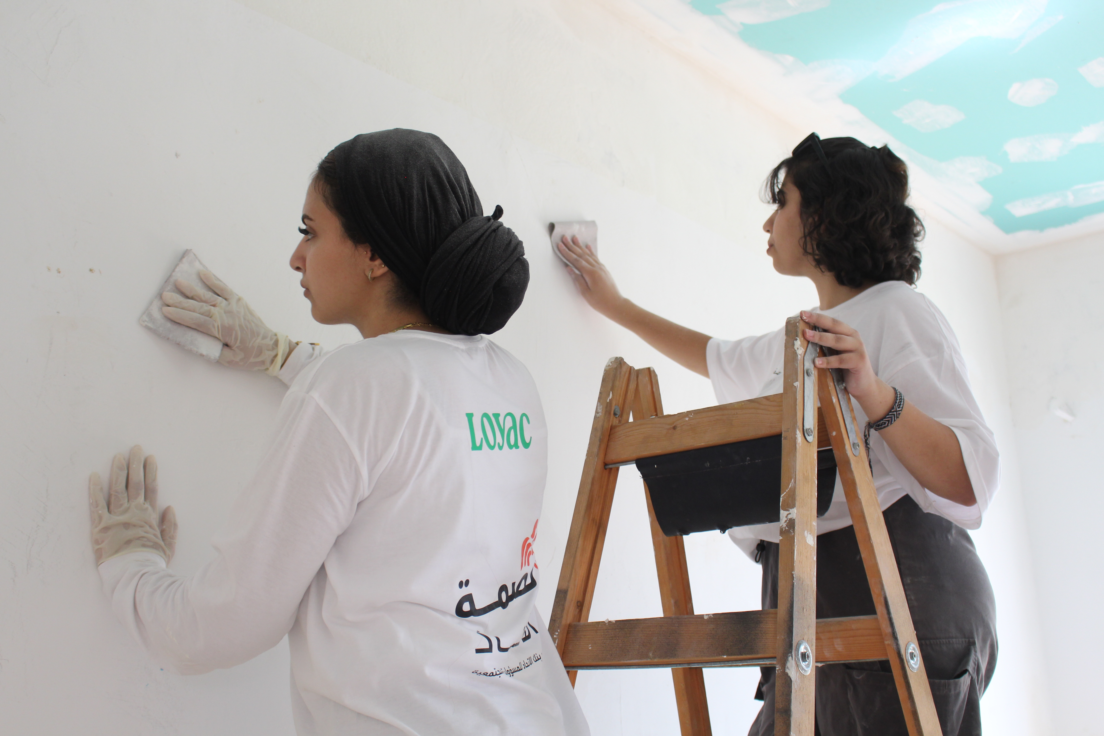
HOMES
The Homes Project is one of LOYAC’s community initiatives, aiming to provide a safe and supportive environment that contributes to social stability and strengthens a sense of social responsibility. This is achieved by improving school environments in less privileged areas. The project focuses on engaging youth and volunteers in field activities that include the renovation and rehabilitation of schools, ensuring a safe and dignified learning environment while promoting values of social solidarity and teamwork. The Homes Project aligns with LOYAC’s mission to create sustainable social impact and empower individuals to actively serve their communities.
In 2025, LOYAC renovated two schools in one of the villages of Ajloun Governorate:
Um Al-Yanabee’ School, renovated with the participation of 16 volunteers, sponsored by Zain.
Tayyara School, renovated with the participation of 25 volunteers, sponsored by Bank al Etihad.
The Homes Project is implemented annually as part of LOYAC’s community programs, reflecting its ongoing commitment to reaching the largest possible number of schools in underserved villages and achieving a positive and sustainable impact on the education sector and local communities.
Page 9

Slide 11
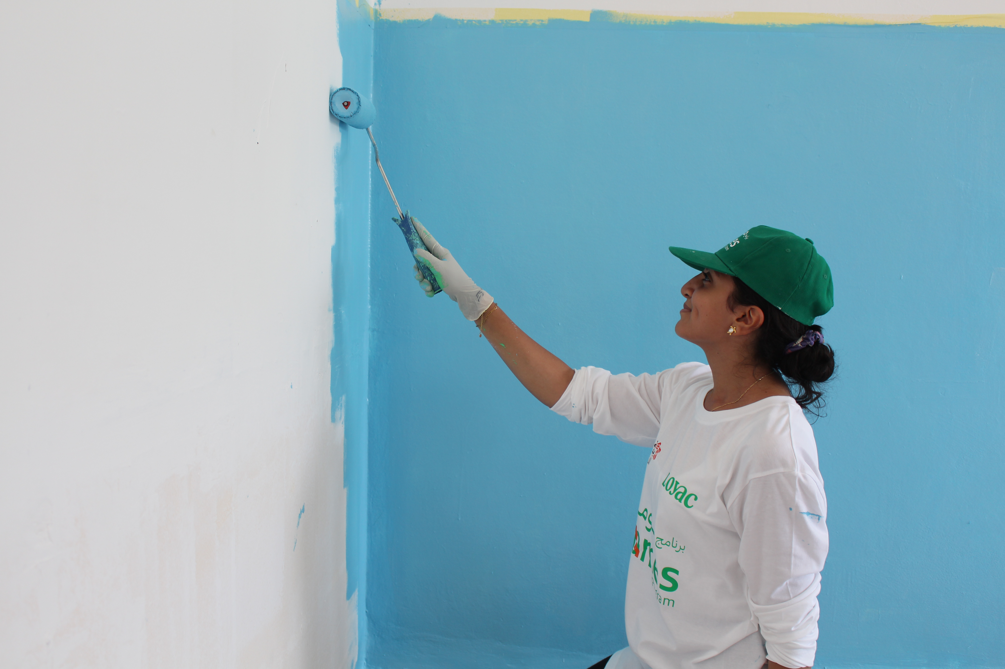
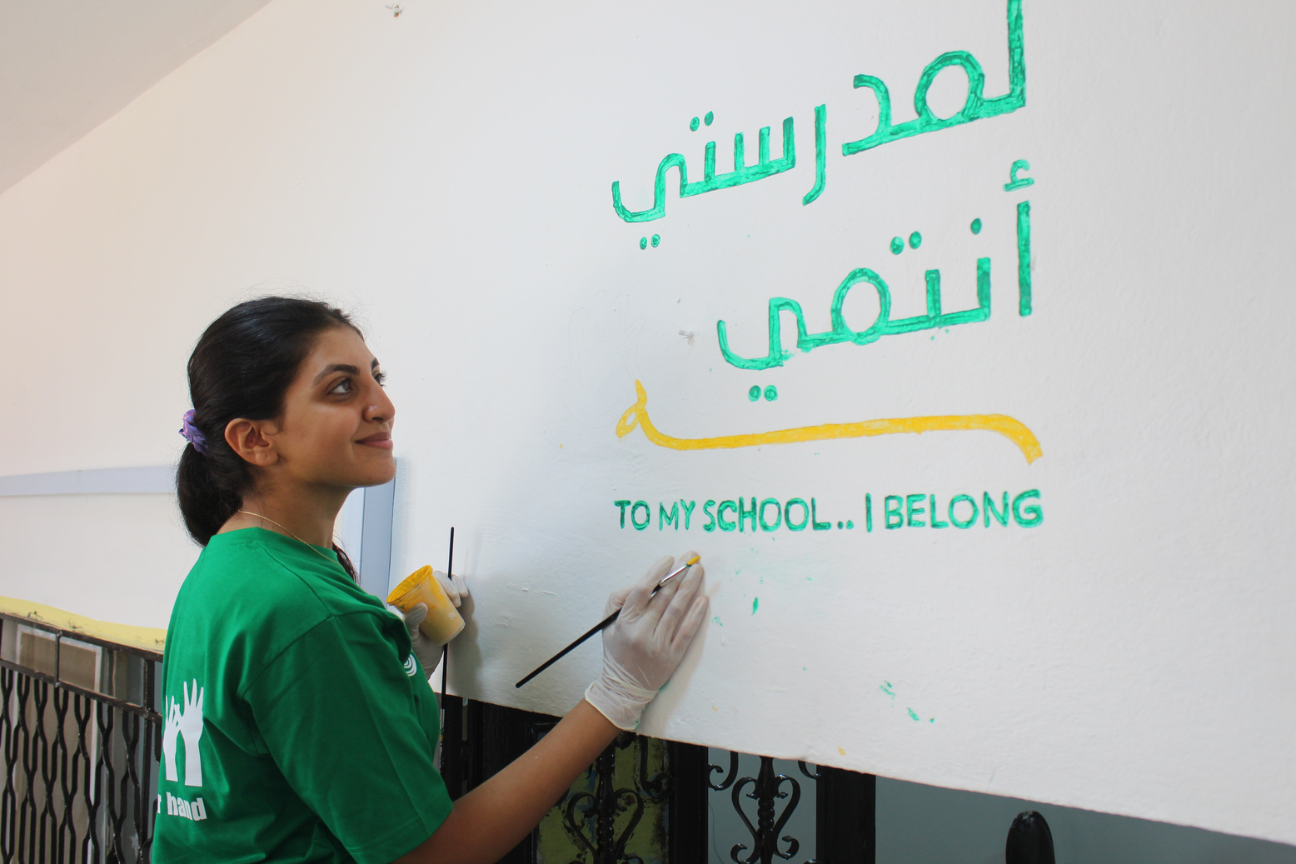
Asan Qasrawi
Volunteer in the Homes in 2025.
Student at the Industrial Engineering faculty of Applied Science University.
I joined LOYAC during my first year at university and took part in several volunteering activities that played a significant role in shaping my character. One of the most impactful experiences for me was participating in the Homes Project, where I contributed to the renovation and rehabilitation of a school.
This volunteering experience had a deep personal impact on me. I became more patient and independent, learned how to work effectively as part of a team, and developed a strong sense of responsibility, even in challenging conditions. During the project, I participated in cleaning, organizing, and painting the school, and I felt a true sense of achievement when I saw the transformation of the space into a cleaner and more welcoming environment for students.
What enriched this experience the most was meeting new people and living a simple life away from comfort. This helped me appreciate the blessings I have and truly understand the value of giving, volunteering, and its positive impact on the community.
Page 5
Page 10

Slide 12
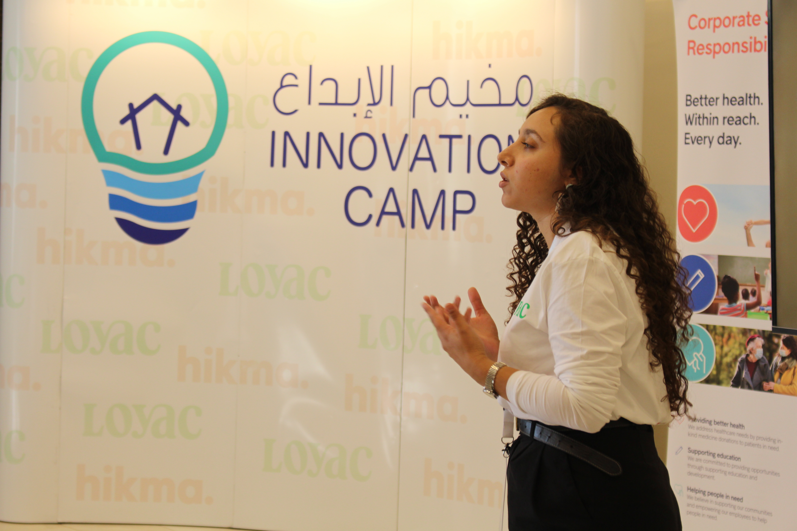
Innovation Camp
Sponsored by HIKMA Pharmaceuticals for the past 6 years, this LOYAC social entrepreneurship program empowers participants with the skills to drive positive social change. The camp’s curriculum is certified by Babson College USA.
Through hands-on learning, mentorship, and entrepreneurship training, the camp empowers participants to think creatively, build problem-solving skills, and develop projects that address pressing societal needs.
By fostering teamwork, leadership, and digital innovation, we are shaping Jordan's youth.
This four-day camp hosts 25 participants and provides a structured, hands-on learning experience,
including:
Day 1: Introduction to innovation and design thinking- exploring problem-solving methodologies.
Day 2: Entrepreneurship and business model development – turning ideas into sustainable ventures.
Day 3: Technology and digital innovation – leveraging tech for impactful solutions.
Day 4: Pitching and presentation skills – preparing participants to showcase their ideas to industry professionals.
To date, over 250 young innovators have participated in LOYAC’s Innovation Camp, gaining essential skills to shape their futures and drive positive change in their communities.
Page 11

Slide 13
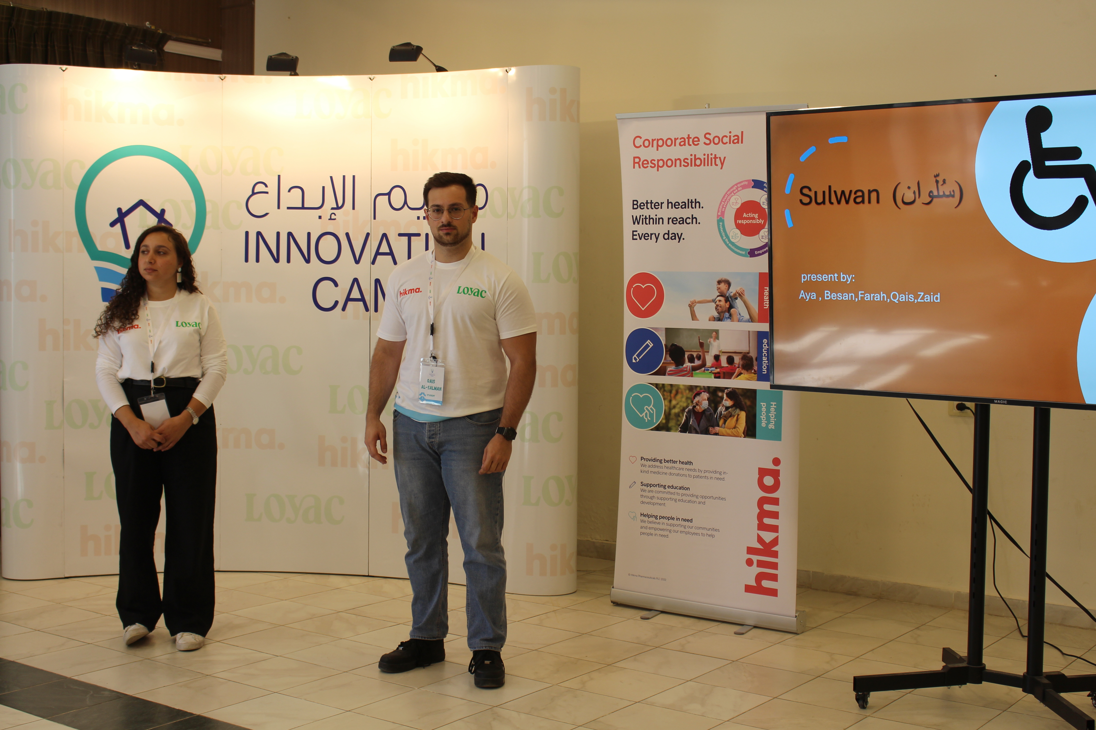
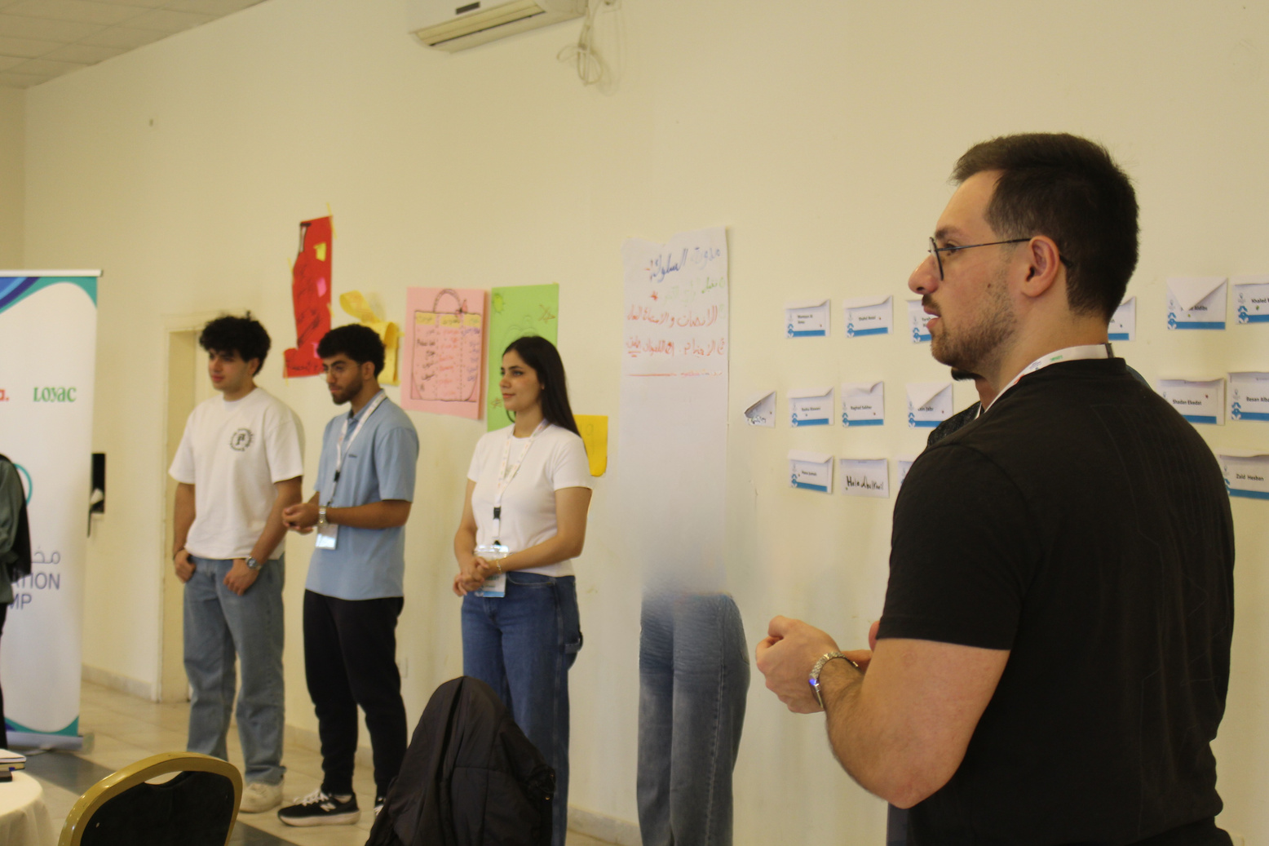
Qais Mwafaq Al-Salman
Participated in the Innovation Camp in 2025.
Student at the Information Technology faculty of German Jordanian University.
The Innovation Camp was an unforgettable journey that awakened my creativity and strengthened my belief in teamwork. Working alongside my amazing team, we transformed an idea into a winning project a powerful reminder that passion, collaboration, and belief can turn a simple thought into something truly extraordinary.
I was incredibly happy and proud when I learned that our team’s project idea had won at the end of the camp. This achievement greatly increased my motivation to explore the challenges faced by persons with disabilities and to think more deeply about the services that could be developed to make their lives easier. It also raised my awareness and helped me realize how much there is to learn and do in this area, something I had not fully understood before.
The camp pushed me to step outside my comfort zone, to listen, to lead, and to see challenges as opportunities for growth. It holds a special place in my heart, reminding me that innovation begins with curiosity and the courage to dream differently. I am truly grateful to LOYAC and Hikma Pharmaceuticals for creating an empowering environment that inspires young minds to dream, build, and contribute to shaping a brighter future.
Page 5
Page 12

Slide 14
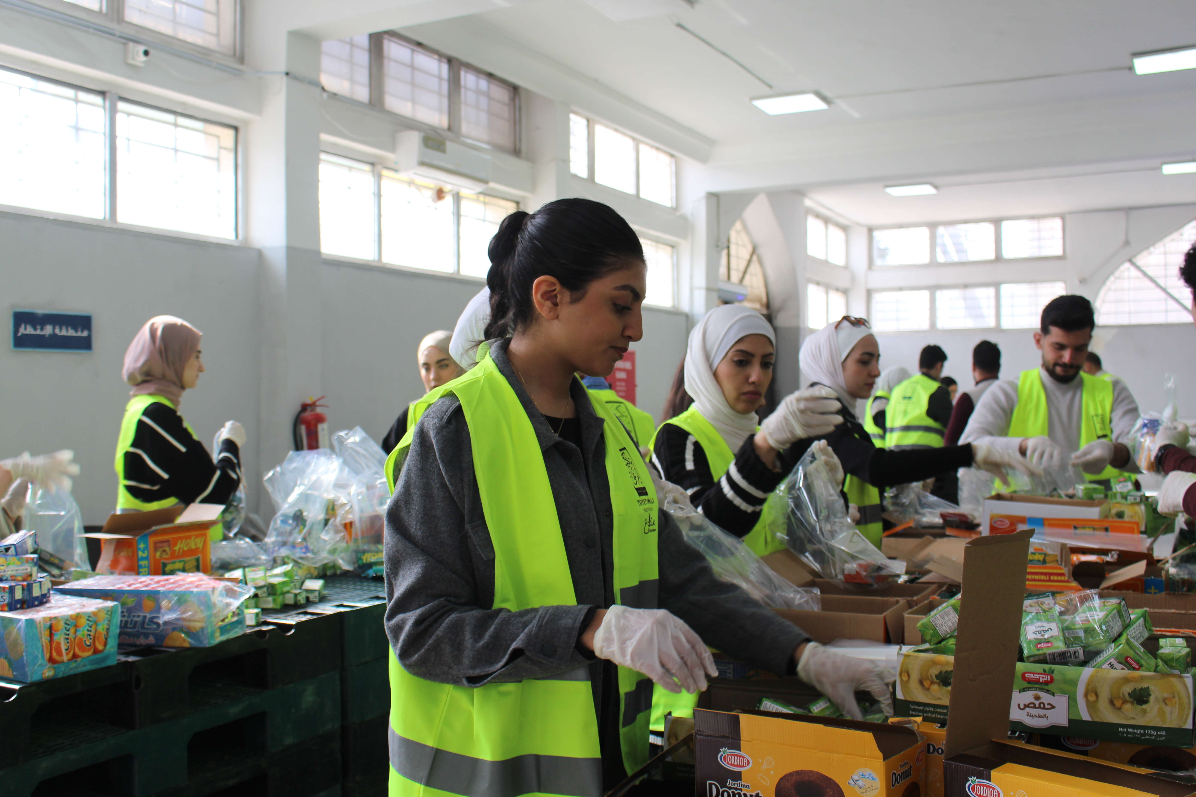
Volunteering and Community Service Program
At LOYAC, community service is a fundamental pillar embedded across all programs, providing participants with meaningful opportunities to engage with their communities and experience the true value of giving back. Through hands-on service, participants develop a strong sense of social responsibility, empathy, and civic engagement, while contributing to sustainable community development.
LOYAC’s Community Service Program has generated a powerful and lasting impact, earning widespread recognition and appreciation from community stakeholders. As a result, both LOYAC and its volunteers are regarded as trusted, valued, and sought-after partners in community-based initiatives.
The program is designed to empower participants to assess the unique needs of their local communities and to take an active role in designing and implementing creative, proactive projects that address these needs while enhancing their surrounding environments. This approach not only strengthens communities but also equips participants with leadership, teamwork, and problem solving skills.
In 2025, a total of 743 volunteers contributed over 6,000 hours of community service, reflecting LOYAC’s continued commitment to fostering active citizenship and creating measurable, positive social impact.
Page 13

Slide 15
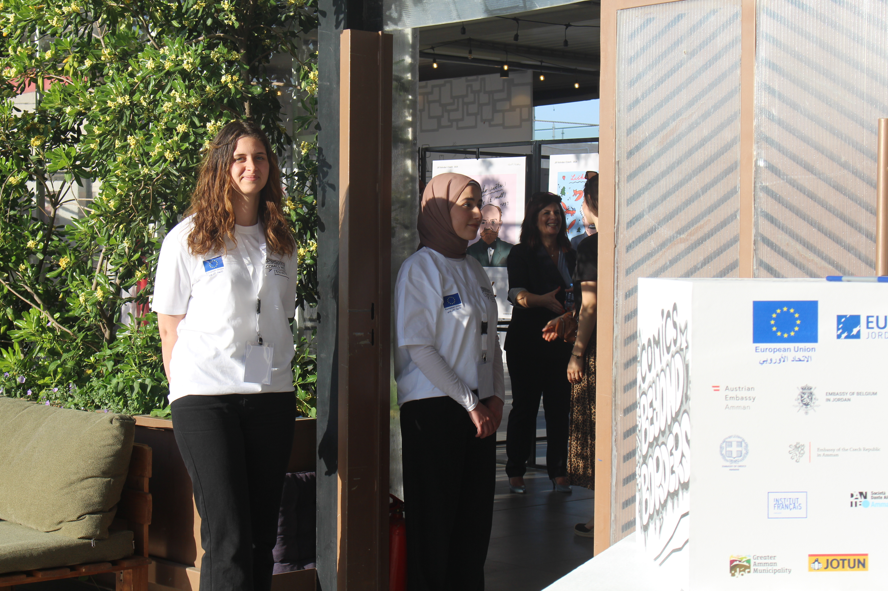
Shahd Alnatour
Volunteer in the Community Service Program in 2025.
Student at the Cybersecurity faculty of Al-Zaytoonah University.
I have been part of LOYAC since 2021, and the Community Service Program was my first experience with LOYAC. Since then, I have participated in many other volunteering activities and became deeply connected to the LOYAC team, who now feel like my second family. Being part of LOYAC has had a meaningful impact on my personality and the way I think, making me more responsible, confident, and aware of my role in serving others.
In 2025, I took part in a wide range of volunteering initiatives through LOYAC, including volunteering at Tkiyet Um Ali and Tkiyet Sayyidna Ibrahim Al-Khalil, renovating a children’s park and a school, supporting dodgeball sports activities, and volunteering at cultural and creative events such as the Amman International Film Festival, Comics Week, and the European Film Festival. These opportunities, made possible through LOYAC and its partners, deepened my appreciation for the value of volunteering and strengthened my commitment to community engagement.
Through these experiences, LOYAC encouraged me to take initiative not only within organized programs but also in my personal life by helping those around me and actively engaging in community-related activities whenever possible.
Page 5
Page 14

Slide 16
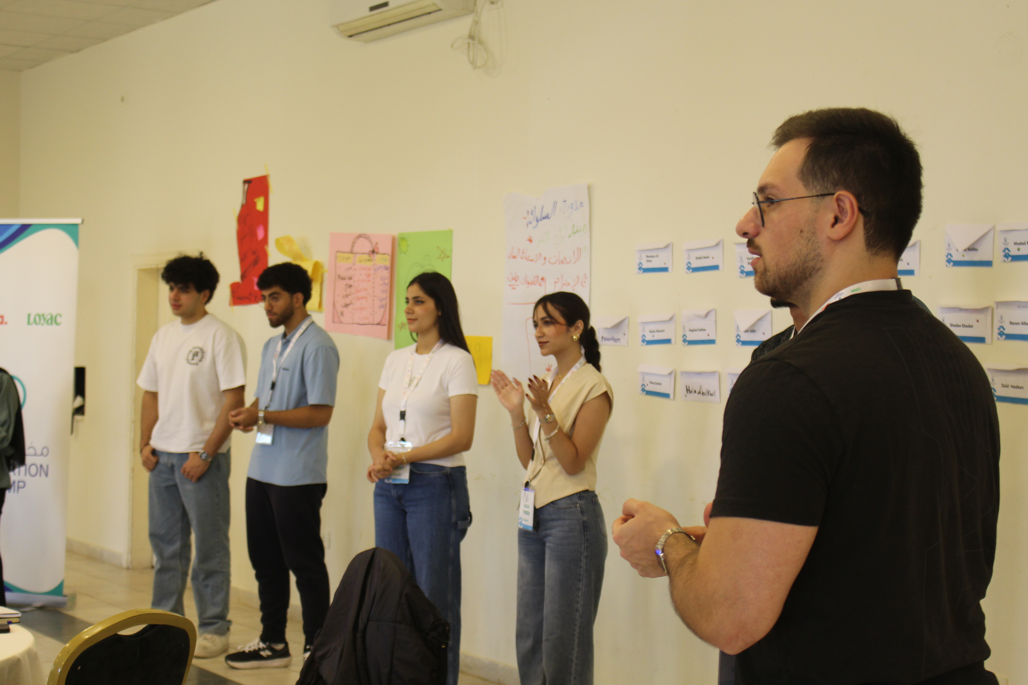




































Our Supporters
Strategic Partners
Donors
Private Sector Internship Partners
Page 15

Slide 17
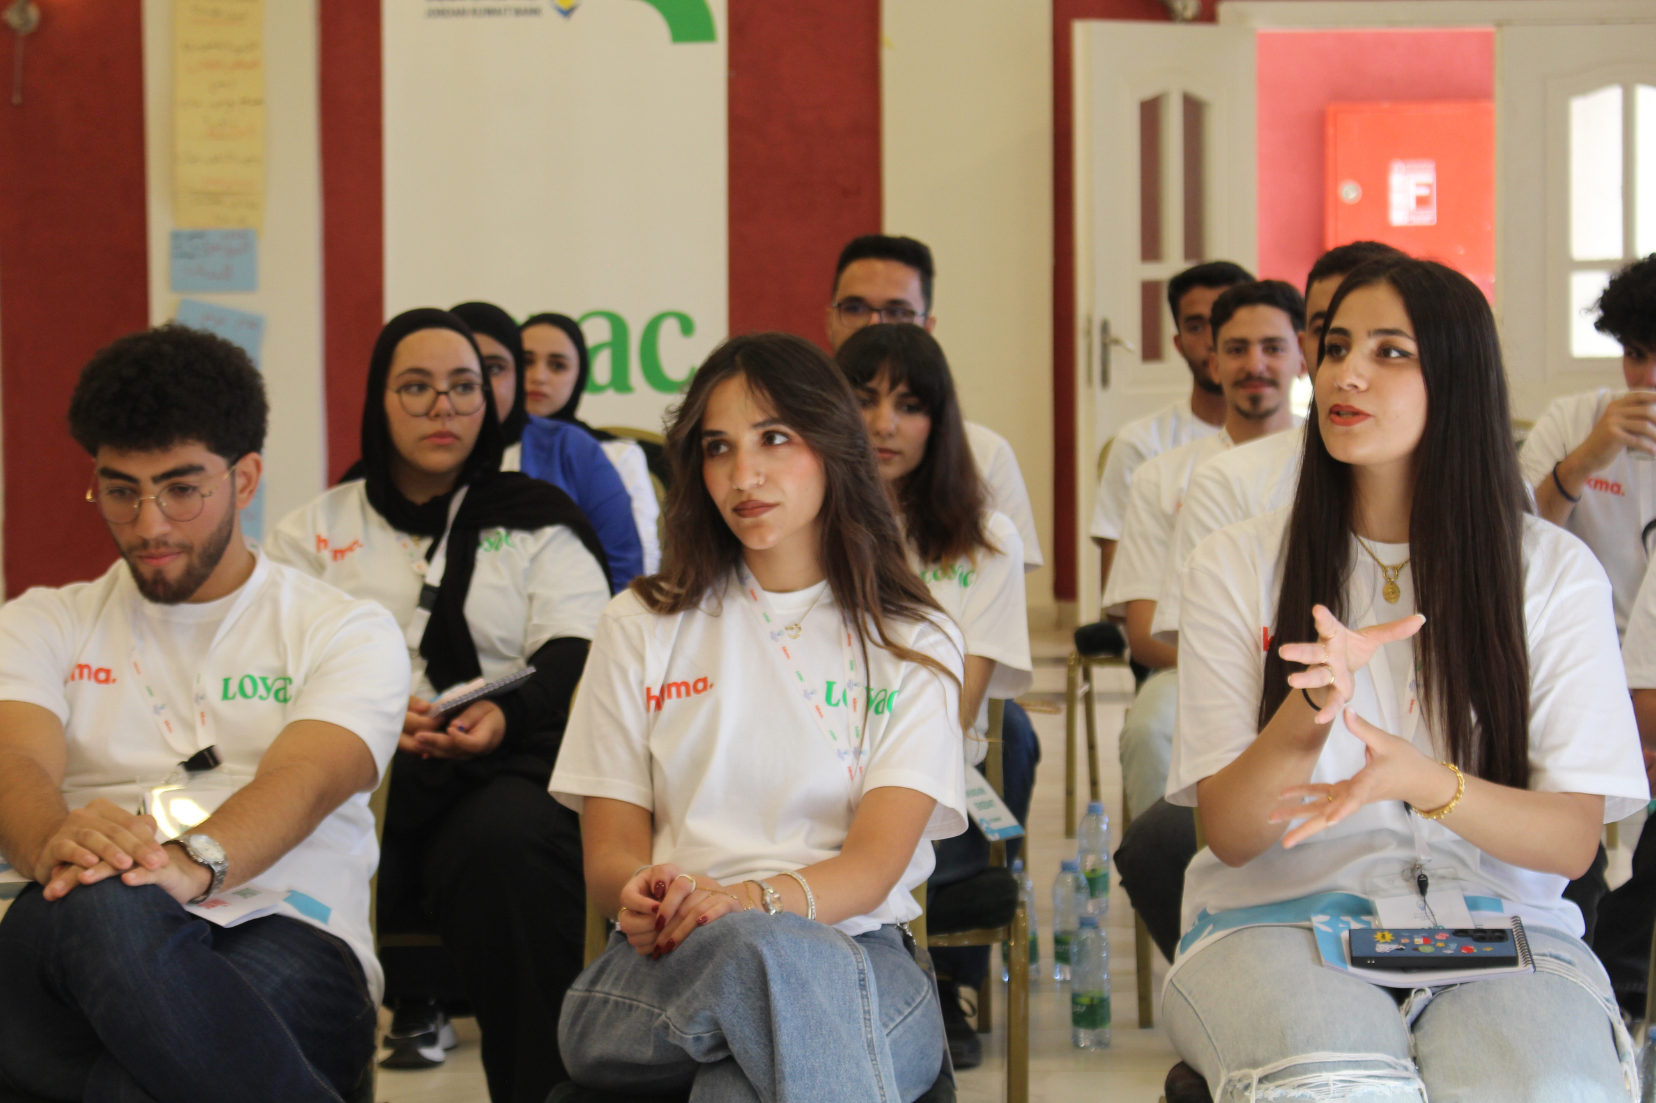




Sponsor a Student. Change a Life.
We strongly believe that a good education is a key to breaking the cycle
of poverty and can create a better future for youth and their families.
That is why we promote education in each of the communities by facilitating sponsorship’s for students who otherwise would not have a chance to attend our programs.
When we invite you to sponsor a student, we are inviting you to invest in the future of Jordan, one student at a time.
Our sponsorship package starts at JOD 300 annually for one student.
+962 6 4636001 +962 79 559 6400
Jabal Al Weibdeh, Ahmad Bin Hanbal Street, Building 88
www.loyacjordan.org
gmjordan@loyac.org
Page 16

